Slide 1

Web Scraping Project :
How much salary can you expect for your tech skill?
Sean Hong
Notes:
Hello, My name is Sean Hong.
This is the first time that I have a presentation.
May be some one never heard my voice.
I'm not good at English.
It has been just 3 weeks since I come to USA, so Please understand.
My topic is <How much salary can you expect for your tech skill?>
I have worked as a programmer, so I am interested in various tech skills.
Let's talk about this topic.

Slide 2

INTRODUCTION
What are your special skills?
JAVA, SQL !
Python, R !
C++ !
Blockchain !
Android, iOS !
Notes:
There are many kind of jobs in the world, and each job needs more than one skill.
And salary also depends on skill level.
Every People want to get salary more than now, so we try to learn new skill and move to another company.
If so, How much salary we can expect with new skills or own skills?
I analyzed jobs which related to computer and data skills with web crawling.

Slide 3
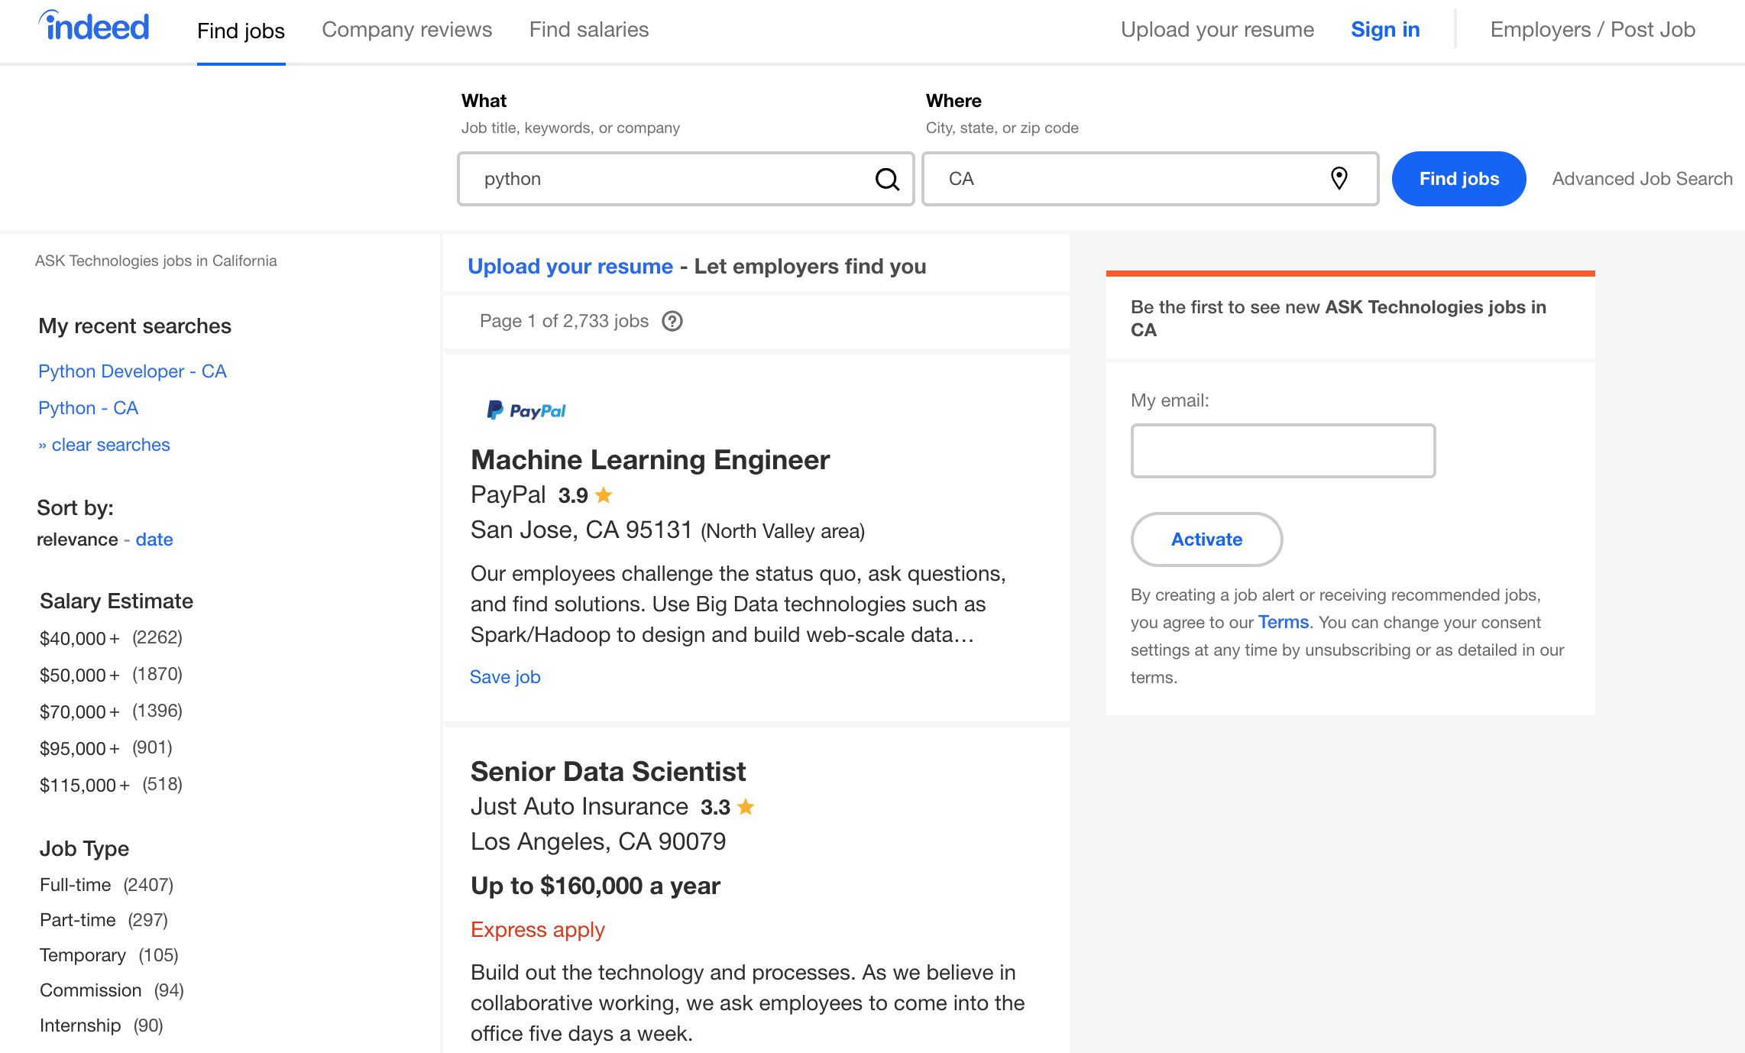
WEB CRAWLING
https://www.indeed.com
keyword
location
salary
Notes:
Indeed.com is search engine which can collect and find job recruit information.
This web has simple interface, and there are several search conditions like job title, company name, keyword and location.
It shows information about company, rate, salary by search result.
I developed scrapy application which input keyword and crawl result.

Slide 4
HOW TO
Web Crawler : Scrapy
Cleansing & Visualization : Pandas, NumPy, Plotly
Search skill keywords from web (stackoverflow, google) & select 25 popular keywords.
java, python, r, sql, hadoop, spark, c#, c++, javascript, angular, node.js, linux, tensorflow, kubernetes, docker, android, ios, aws, azure, kafka, vb, php, scala, go…
Develop scrapy application to Input each keyword into indeed.com search engine.
URL : https://www.indeed.com/jobs?q={keyword}&l={location}&limit=50&start={50 * (page -1)}
Iterate keywords & collect job results of URL request call.
Skip job results that have not salary information.
Save to CSV file.
There is 1,000 count limitation of search result.
Add more condition to get more sample
Location : CA, NY, FL, TX…
Level : entry, mid, senior
Notes:
I use scrapy for crawling, and Pandas, NumPy, Plotly for data cleansing and visualization
1. indeed.com does not offer skill category, so I had to find skill keywords by myself.
Because there are so many computer or data skills, I select 25 popular skill keywords.
java, python, r, sql.... I found These keywords from stackoverflow and google web.
2. URL is like this. There are some parameters for search conditions.
Search keyword, location and start parameter is page to move.
3. After define URL, I iterate these keywords and collect job results with scrapy.
I skipped job results that don't have salary information.
4. However, there is limitation of result count. limit is one thousand per each search.
I add more condition to get more result. because collecting sample is import.

Slide 5
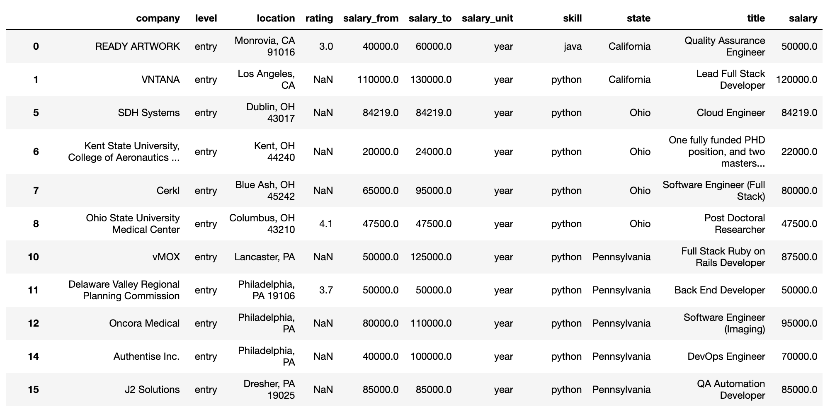
DATA SET
salary = (salary_from + salary_to) / 2
If salary unit is month, salary * 12
Notes:
This is dataset that I collected with scrapy.
I add average salary for each row.
And if salary unit is month, it converted to annual salary.

Slide 6
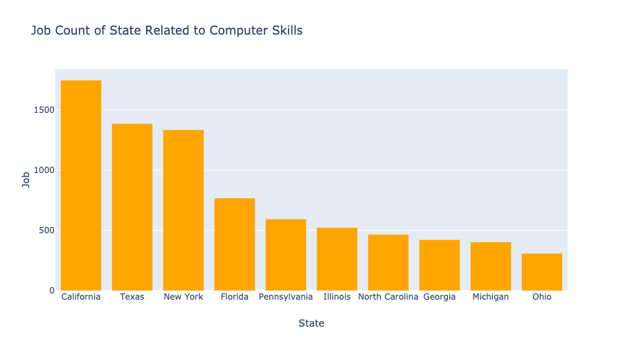
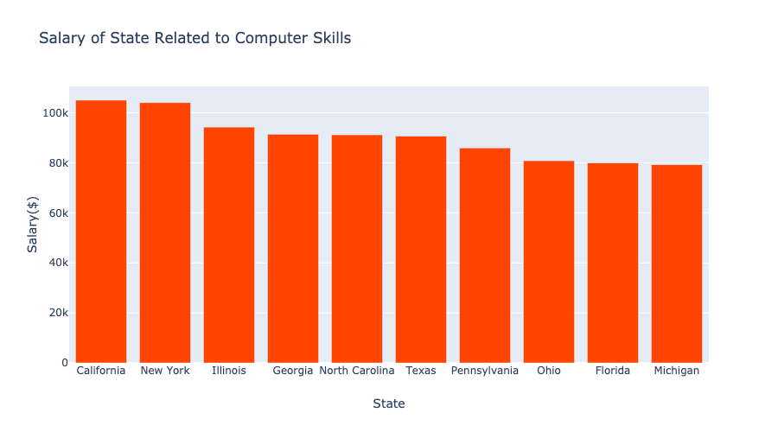
BASIC STATISTICS #1
Job count seems to depends on population. But New York is much higher than Florida.
California & New York has the highest average salary.
Notes:
This is basic analytic result.
Left is job count of state related to searched skills, Right is the salary.
left : Job count seems to depends on population. But New York is much higher than Florida.
right : California & New York has the highest average salary.

Slide 7
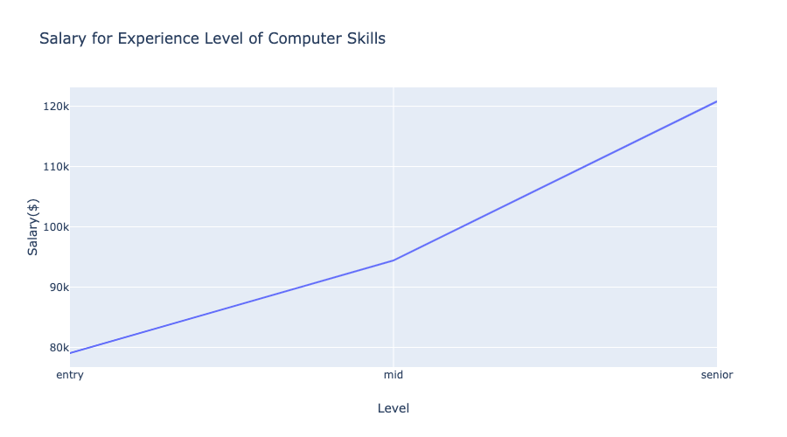
BASIC STATISTICS #2
Absolutely, skill level is related to salary. Level is one of search condition from indeed.com.
Notes:
And indeed.com offer search condition for skill level.
I searched skills with every levels.
You can see senior level get much more salary.

Slide 8
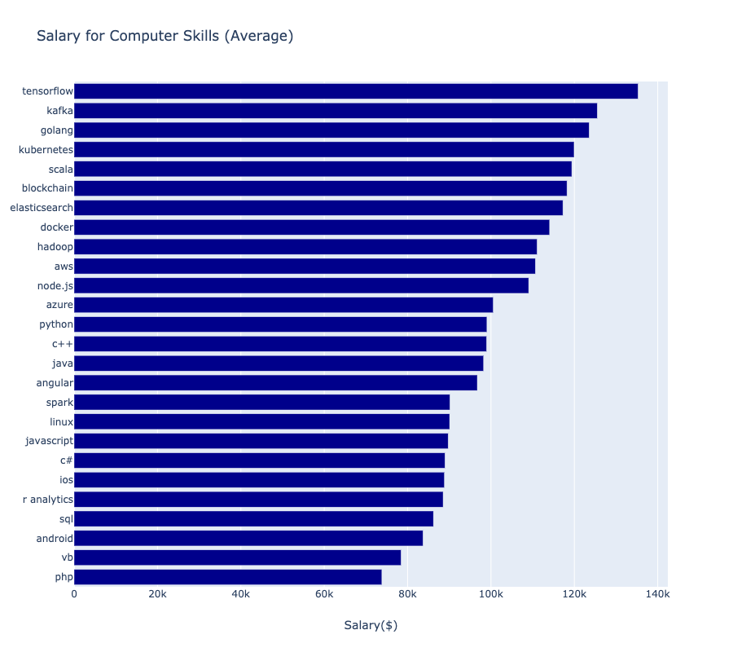
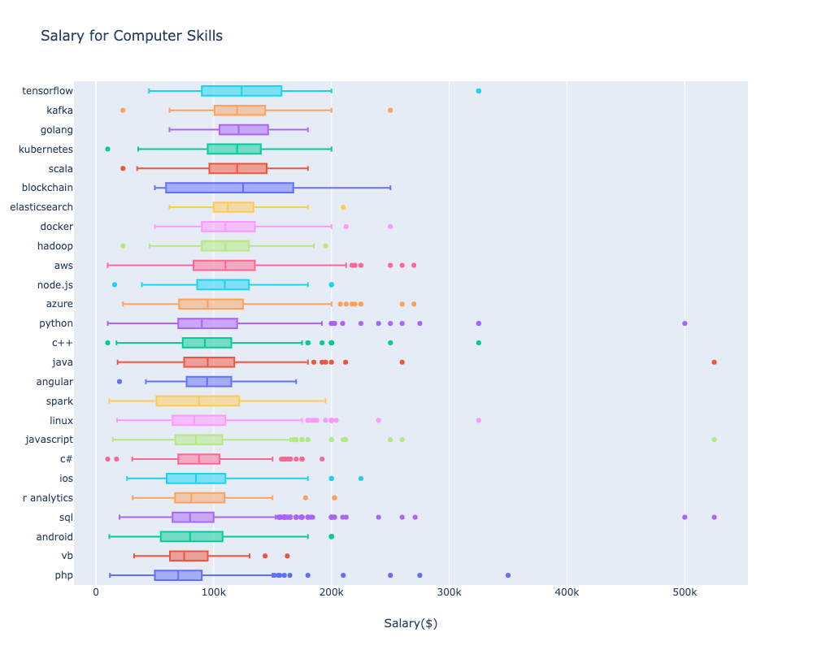
MAIN ANALYSIS #1
It looks the latest technology’s skills (AI, Cloud, Blockchain) can get high salary.
Notes:
This is main analytic result which related my question. (how much salary you can expect)
tensorflow is the best, and kafka, go, kubernetes follow that.
It seems...
Old skill's salary looks lower. latest skill AI, Cloud, Blockchain.. can get high salary.

Slide 9
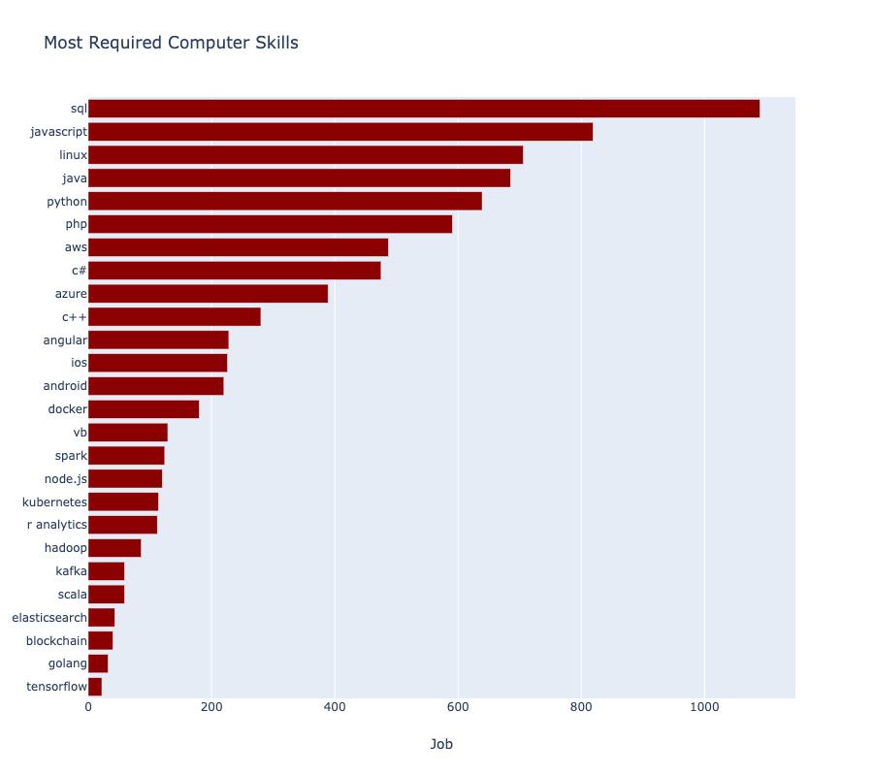
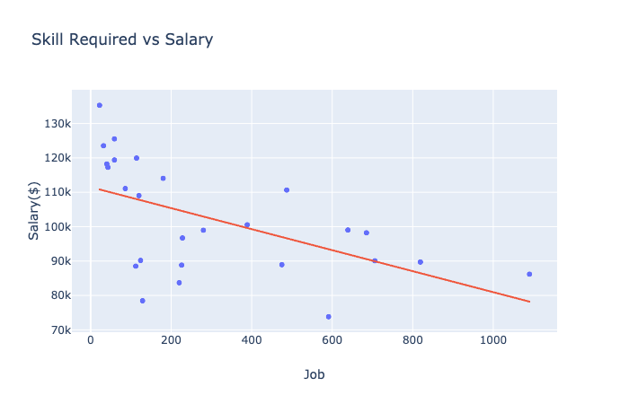
MAIN ANALYSIS #2
Most common skill is SQL. Because It uses everywhere.
Common and general skill seems that cannot get high salary. Learn special tech skill!!
Notes:
And I want to find the relation between skill count and average salary.
I created scatter plot which shows relation. And I added regression line.
As you see, Most common skill is SQL. Because I think it is used everywhere. When we develop program, also when we analysis data..
So, Common or general skill seems that cannot get high salary.
Recently, AI, Cloud, Blockchain is popular but there are not many people who is good at that kind of skills.
That makes salary is higher.
If you want to get more salary, you should learn new special skills. That's my conclusion.

Slide 10
FUTURE WORK
If skills are more than one, is it relate to get more salary?
Try to search combined keyword.
Ex) java + sql, python + r…
Amount of sample is not enough because many companies don’t want to show their salary directly.
Find how to get more sample.
Use machine learning and predict salary.
Notes:
If I had more time, I would tried to search combined skill and their relation.
It takes long time to collect combined keyword. There are many combinations.
And amount of sample is not enough.. because many companies don’t want to show their salary directly.
Only 20% shows their salary.
I think I can use machine learning to predict salary.
If I train many job data which have salary information, I can predict job data even that have not salary information. Like impute missing values.
That's all of my presentation. Thank you for listening.

